Slide 1

Food Desert Investigation
October 2024

Slide 2

Context
According to the U.S. Department of Agriculture’s Economic Research Service (ERS), accessibility and affordability of food retailers, distance to food retailers, and the availability of high quality, healthy food options all impact people’s decision-making regarding food spending and eating habits. ERS highlights the impact of intersectionality, specifying that income level, location, and demographic factors all coalesce to influence consumers’ diet and health outcomes.

Slide 3

Machine Learning Decision: Clustering
Unsupervised learning was chosen because the data lacked clear output variables.
Clustering was chosen to group similar data points based on the features affecting food insecurity.
Methods tested:
K-Means
Affinity Propagation
Spectral Clustering
Agglomerative Clustering
DBSCAN

Slide 4
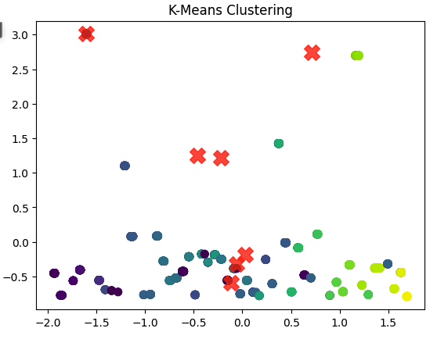
K-Means
Silhouette Coefficient: 0.541
Number of Clusters: 443

Slide 5
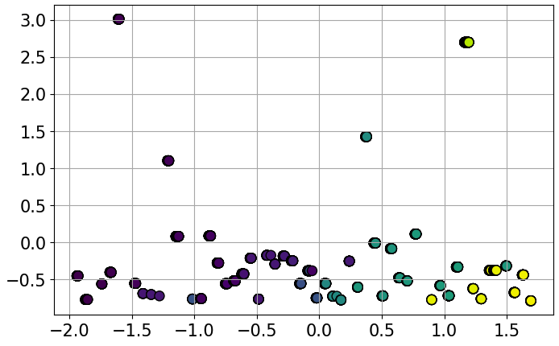
Affinity Propagation
Silhouette Coefficient: 0.541
Number of Clusters: 443

Slide 6
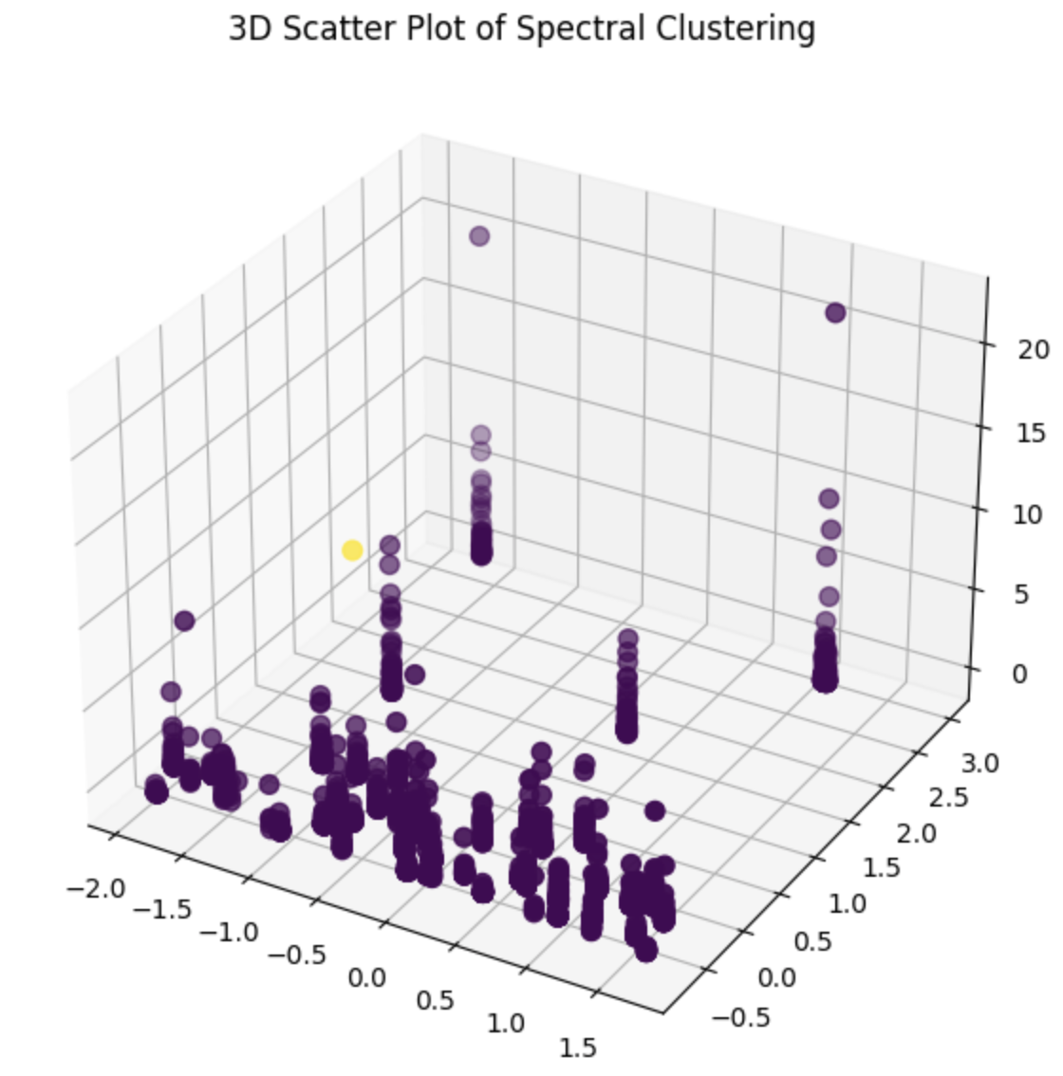
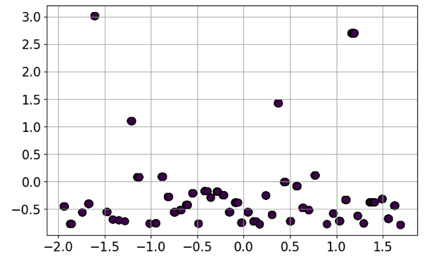
Spectral Clustering
Silhouette Coefficient: 0.966
Number of Clusters: 443

Slide 7
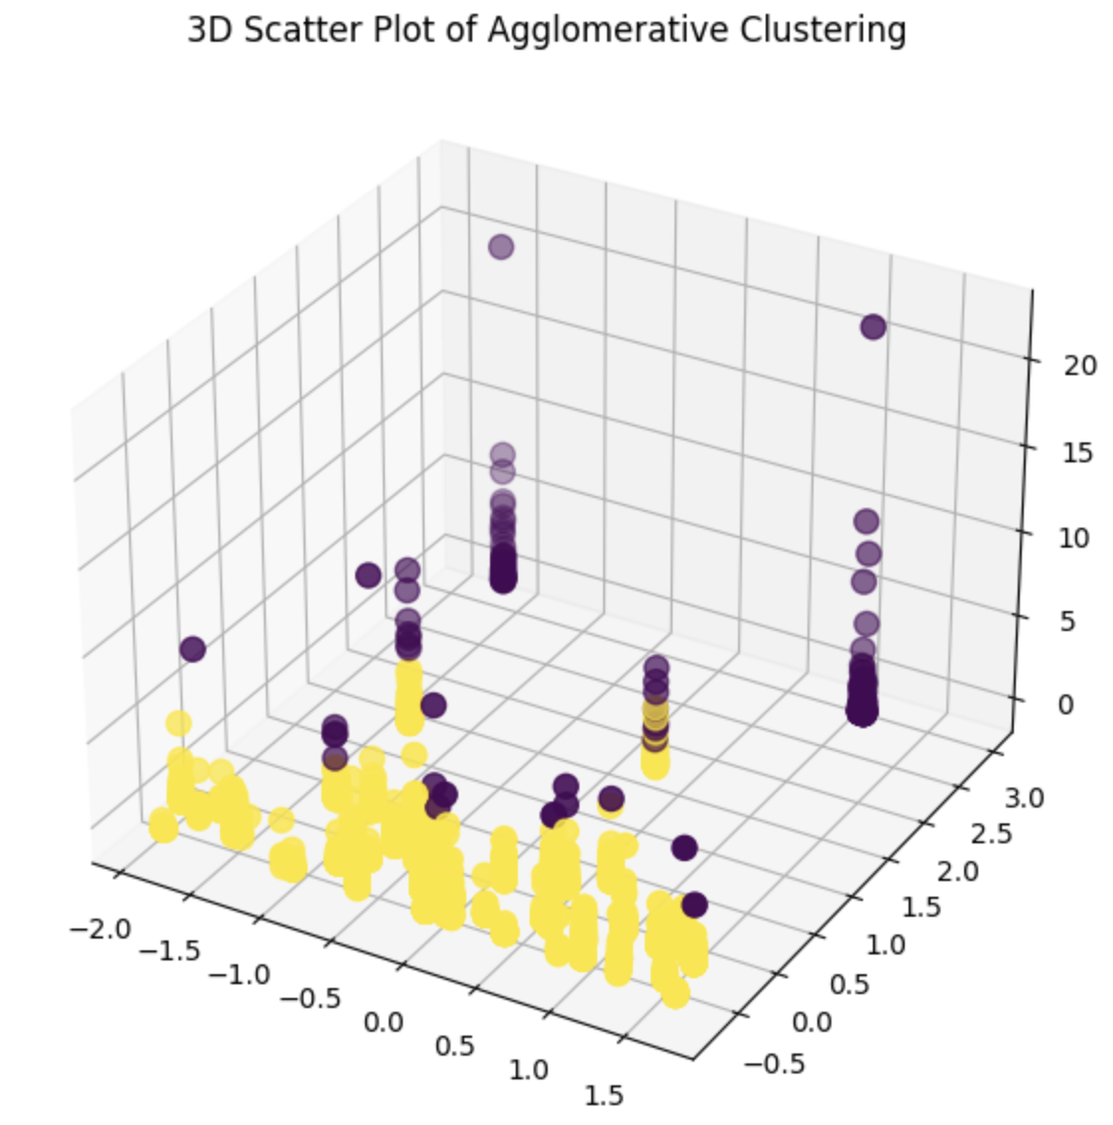
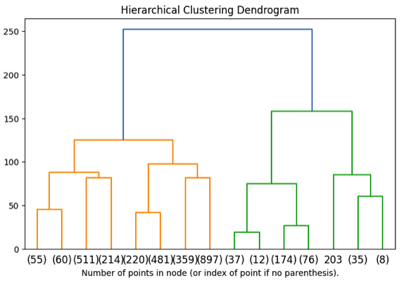
Agglomerative Clustering
Silhouette Coefficient: 0.500
Number of Clusters: 2

Slide 8
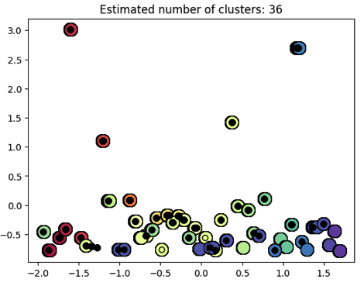
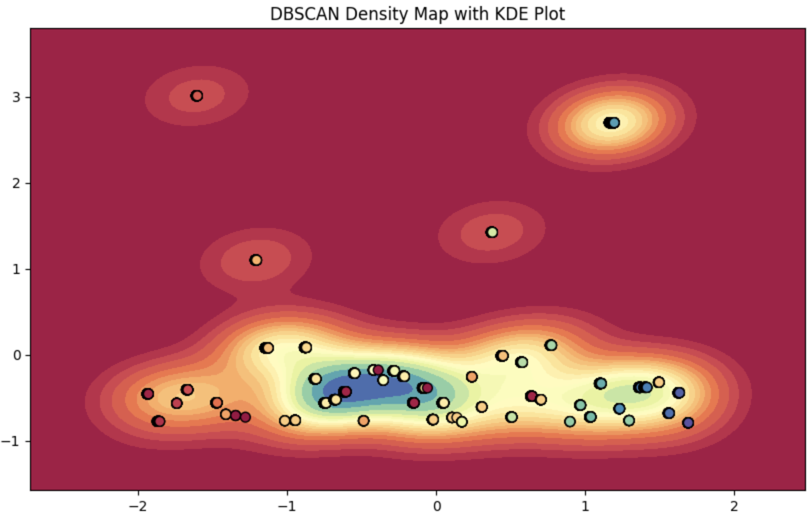
DBSCAN
Silhouette Coefficient: 0.469
Number of Clusters: 36

Slide 9
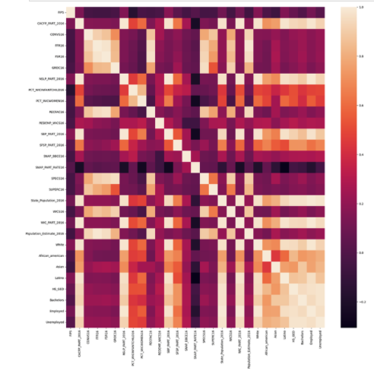
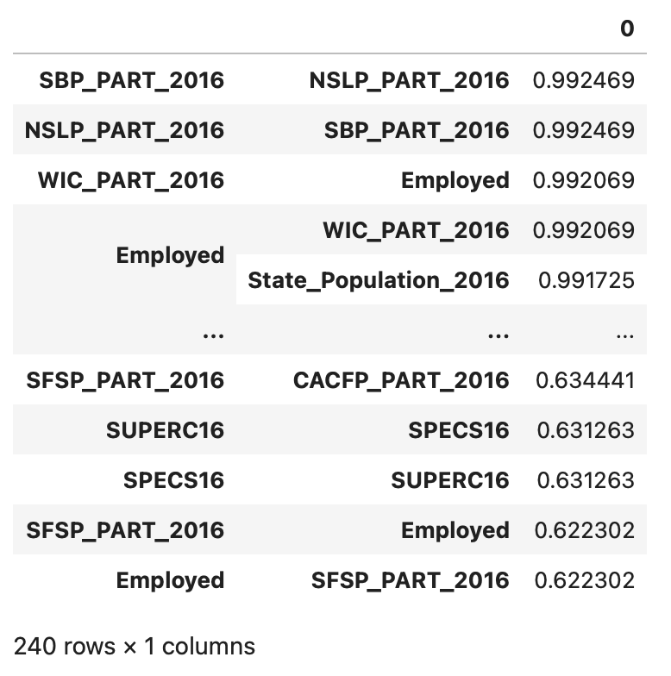
EDA

Slide 10
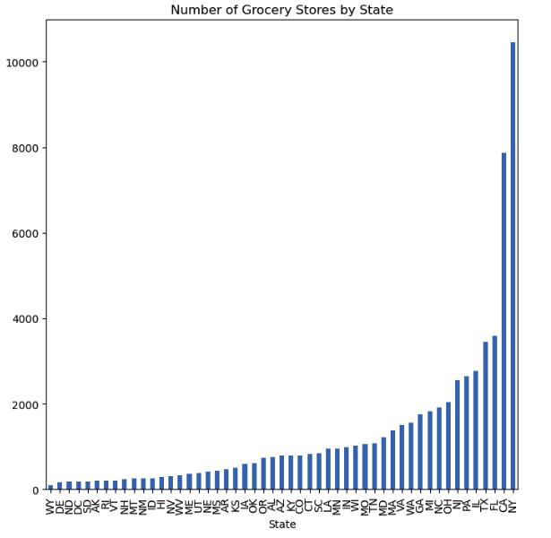
EDA
The graph is skewed by state population.

Slide 11
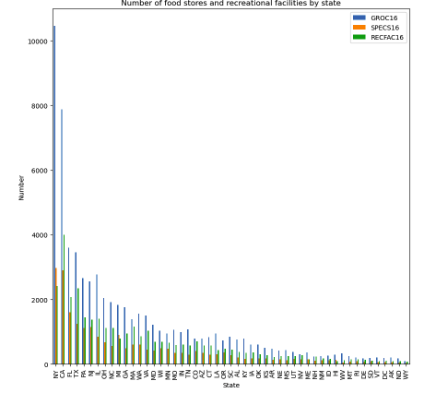
EDA
The results show more about state infrastructure and population than food security.

Slide 12
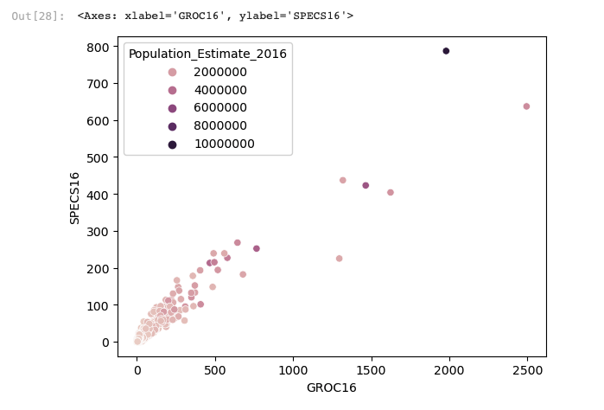
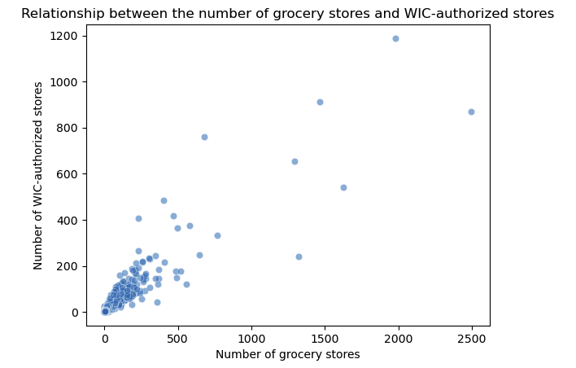
EDA

Slide 13
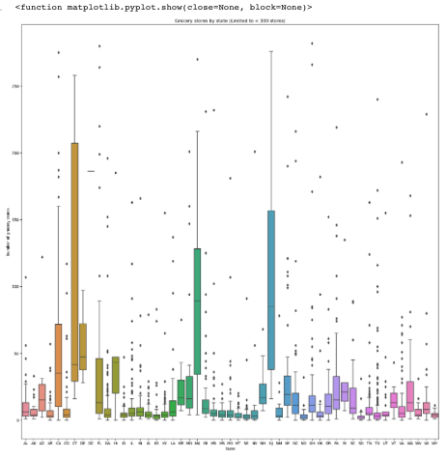
EDA
Box plots show the variation within each state.

Slide 14

Next Steps
Demographic analysis
County—level analysis
Infrastructure analysis

